Slide 1
Garage Smart Alarm IoT project Brought up by Khaled Mohamed Matthew Bahgat Habiba Ahmed Yassin Mahmoud Abdelrahman Gomaa

Slide 2
Introduction
The Smart IoT Garage Alarm System is designed to make your garage smarter and safer.
a system that constantly watches over your garage, keeping track of temperature, humidity, motion, sound, and even gas levels—all automatically.
The system uses the ESP32 microcontroller, which connects to a range of sensors. If something unusual happens, like a spike in temperature or the detection of motion, the system instantly reacts.
It can sound an alarm, open or close the garage door, and display alerts on an LCD screen.

Slide 3
Objective
Is to Create a smart IoT alarm system for a garage that monitors temperature, humidity, motion, sound, and gas levels. The system aims to enhance safety and automation by alerting the user when any sensor detects abnormal conditions. The project uses an ESP32 microcontroller, integrates various sensors, and provides real-time feedback via an LCD screen and a buzzer.

Slide 4
History
The smart IoT alarm system continuously monitors the garage environment using multiple sensors. If any sensor detects an abnormal condition, the system triggers appropriate actions:
Temperature/ Humidity | Motion | Sound | Gas | Real-time alerts
Opens the door and activates the buzzer if thresholds are exceeded | Opens the door for a set time when motion is detected, allowing the car to exit | Opens the door and rings the buzzer with distinct pattern if level is above threshold | Also opens the door and rings the buzzer with a different pattern if gas level is above threshold | On top of the buzzer ringing and door opening, the LCD displays a real-time alert specifying the problem

Slide 5
Key components
• ESP32 Microcontroller
• DHT22 Sensor (Temperature & Humidity)
• PIR Motion Sensor
• Sound Sensor
• MQ-2 Gas Sensor
• Servo Motor
• LCD Display
• Buzzer
• Keypad

Slide 6
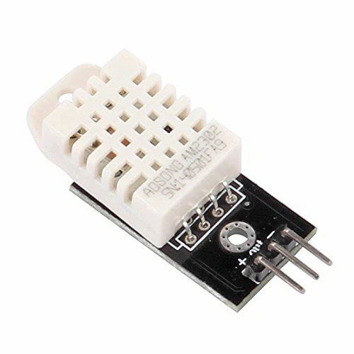
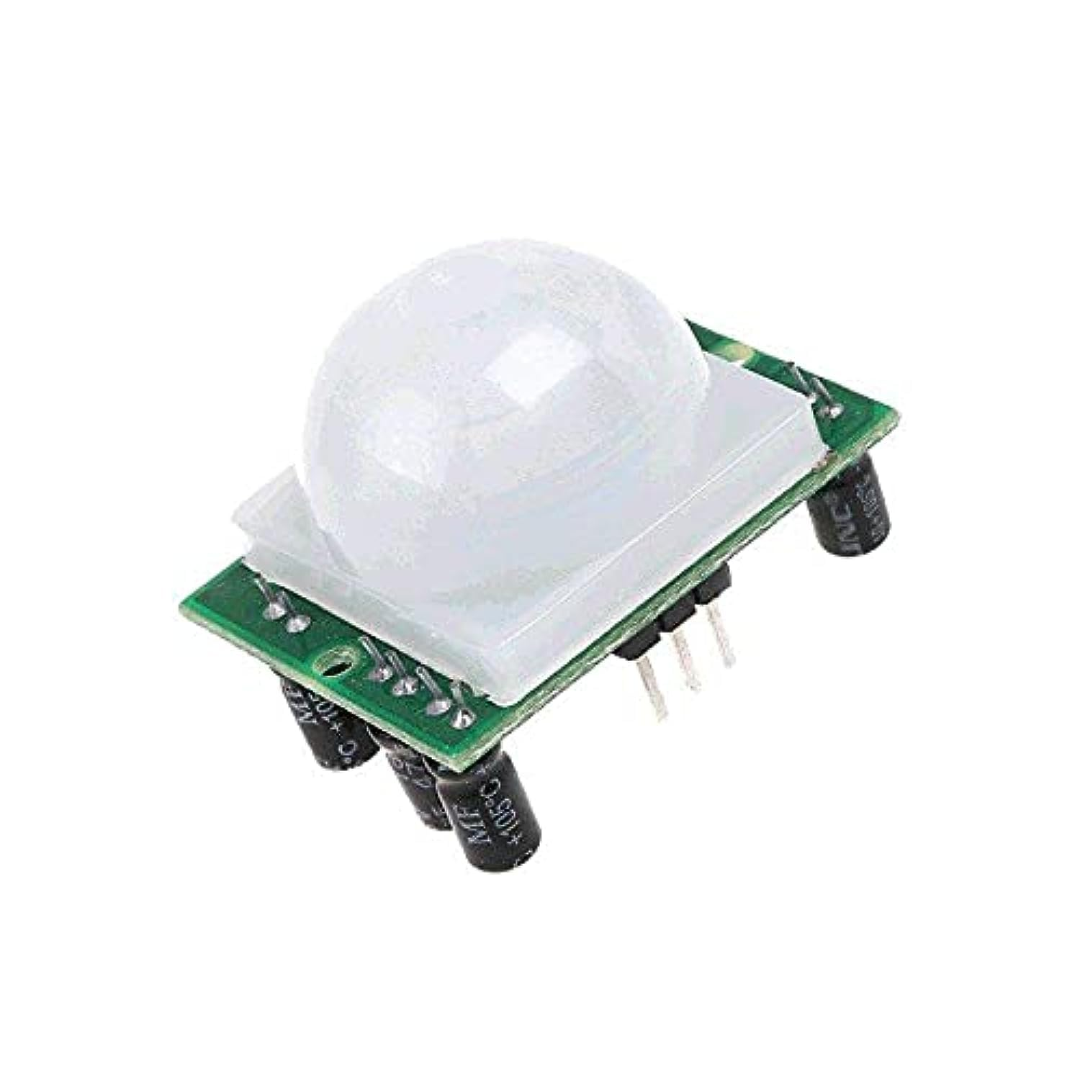
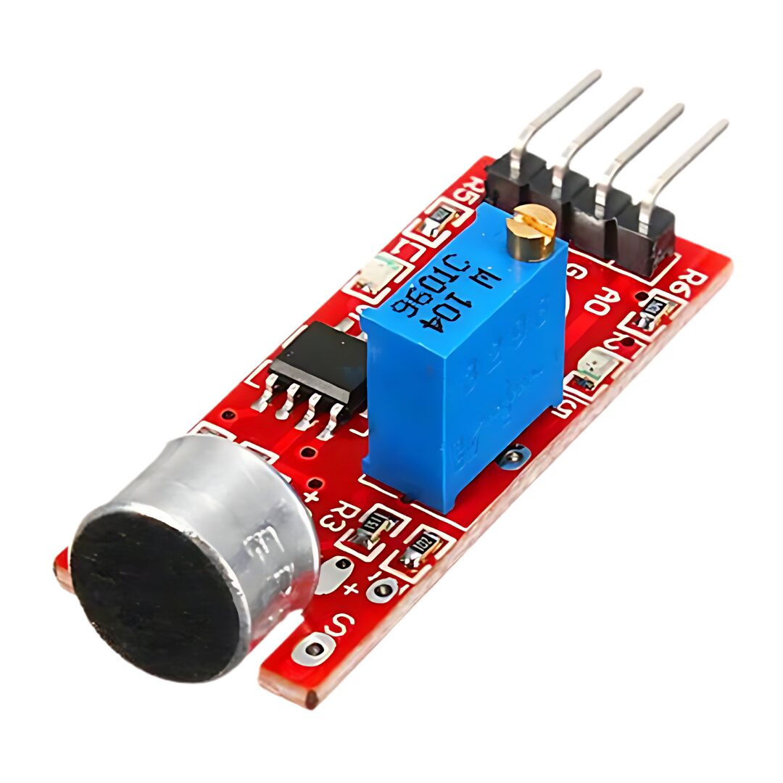
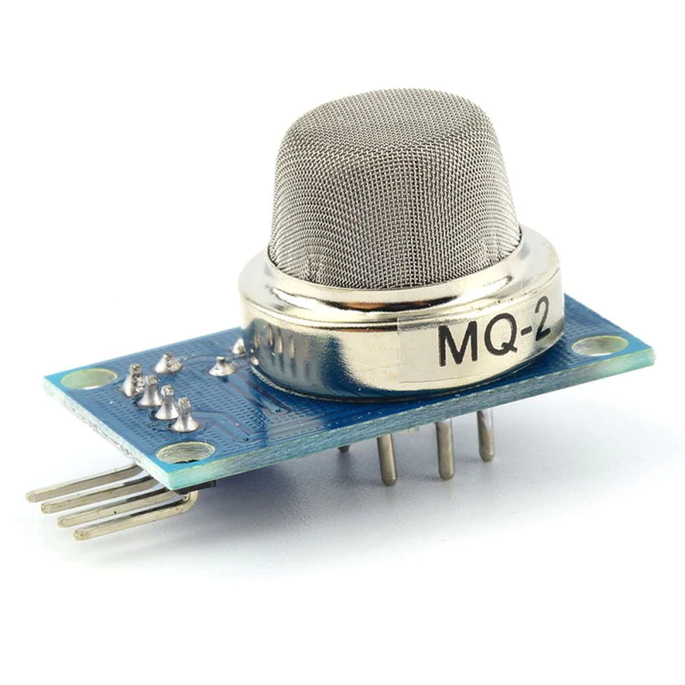
Sensors used
The project uses the following 4 sensors to provide its functionality
Detects the presence of gases (like smoke)
Measures temperature and humidity.
Detects motion within the garage
Monitors noise levels

Slide 7
Frameworks used
• Arduino IDE
• PubSubClient Library (MQTT)
• DHTesp Library
• ESP32Servo Library
• Keypad Library

Slide 8
Circuit build
ESP32: GPIO 4: DHT22 sensor data pin. GPIO 2: PIR motion sensor data pin. GPIO 34: Sound sensor analog output. GPIO 35: MQ-2 gas sensor analog output. GPIO 18: Servo motor control. GPIO 16: Buzzer control. GPIOs 13, 12, 14, 27 (Rows) & 26, 25, 33, 32 (Columns): Keypad connections.
Power Supply: - 3.3V: Powers DHT22, sound sensor, and gas sensor. - 5V: Powers the PIR sensor, servo motor, and keypad.
Ground (GND):all components are connected to a common ground.

Slide 9
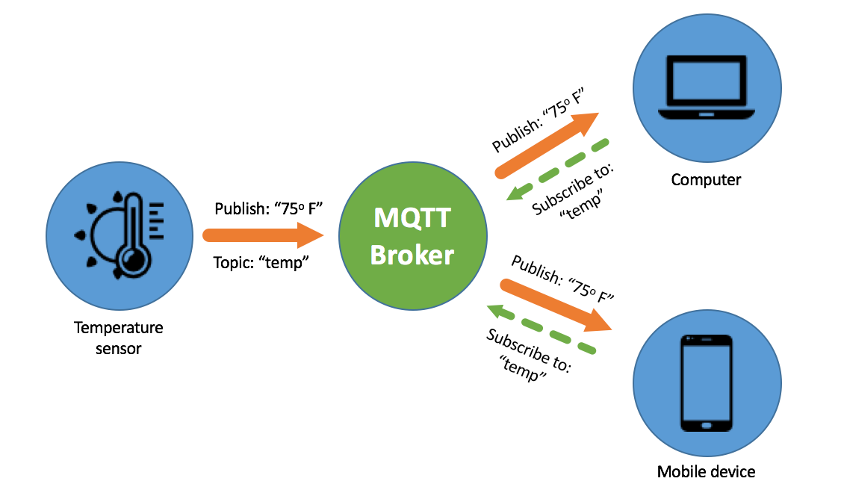
MQTT Communication
The Smart alarm is connected to a MQTT broker using a local IP address, it sends 5 topics under the category home/garage
Motion detection status
Temperature
Humidity
Sound level
Gas level

Slide 10
Flutter App
A key feature in this project is the flutter app that will be connected to the MQTT broker as a subscriber to the specific MQTT topics to receive real-time updates from the smart alarm system. For example, here are the topics it might subscribe to:
‘home/garage/temperature’ ‘home/garage/humidity’ ‘home/garage/sound’ ‘home/garage/gas’ ‘home/garage/motion’

Slide 11
Sensors Logic
Temperature & Humidity:
Thresholds: The system continuously monitors the environment's temperature and humidity using the DHT22 sensor.
- Temperature Threshold: 37°C.
- Humidity Threshold: 67%.
Response:
- When either threshold is exceeded, the system triggers the following actions:
Door Mechanism: The servo motor opens the door.
Buzzer Alert: The buzzer rings to alert users of the condition.
The system will maintain these responses until the values return to normal, at which point the door closes, and the buzzer stops.

Slide 12
Sensors Logic Cont.
• Motion Detection:
- Sensor: The PIR motion sensor detects any movement within its range.
- Trigger:
Upon detecting motion, the system automatically opens the door using the servo motor.
The door remains open for 10 seconds before closing, providing enough time for safe passage.

Slide 13
Sensors Logic Cont.
Sound & Gas Sensors:
Sound Sensor: Monitors ambient noise levels.
Threshold: 100 units.
Gas Sensor (MQ-2): Detects hazardous gas concentrations.
Threshold: 2500 units.
Alert Mechanisms:
When the sound or gas levels exceed their respective thresholds:
Buzzer: The buzzer rings with distinct patterns for each sensor, alerting users to potential danger.
Door Mechanism: The servo motor opens the door to ensure safety.
Once levels return to normal, the system resets, closes the door, and the buzzer stops.

Slide 14
Keypad & Security
Password System Description:
The system incorporates a 4x4 keypad for secure access control.
Password: A predefined 4-digit password ('1234') is required to operate the door manually.
Lock/Unlock Mechanism:
Locking:
When the correct password is entered via the keypad, the system closes the door (servo angle set to 0) and locks it.
Once locked, the system temporarily disables sensor-triggered door operations to ensure security.
Unlocking:
To restore normal sensor functionality and allow the door to open automatically, the user must press the '#' key.
Pressing '#' re-enables all sensor-based triggers and returns the system to its monitoring state.

Slide 15
Buzzer & Alerts
- Alert Mechanism Description:
The system uses a buzzer to provide audible alerts for different sensor-triggered events.
The buzzer is activated when certain thresholds are exceeded, such as temperature, humidity, sound level, or gas concentration.
Different Patterns for Different Alerts:
Temperature/Humidity Exceeding Thresholds:
Continuous buzzing until the temperature or humidity returns to normal.
Sound/Gas Sensor Activation:
Sound Sensor: Short, repeated beeps indicating noise levels above the set threshold.
Gas Sensor: Long, steady beeps signaling dangerous gas levels.
Motion Detection:
No buzzer alert is used, as this triggers the door mechanism directly.

Slide 16
LCD Display
Explanation of Display Scenarios:
Normal Operation:
The LCD alternates between showing the current temperature and humidity levels every 0.5 seconds.
Threshold Exceeded:
If the temperature exceeds 37°C or humidity exceeds 67%, the LCD displays the alert, showing which specific threshold is exceeded and its current value (e.g., "High Temp: 38°C").
Motion Detected:
When motion is detected, the LCD shows "Motion Detected" while the door is open for 10 seconds.

Slide 17
LCD Display
Sound/Gas Threshold Exceeded:
Displays "High Sound" or "Gas Detected" along with the current reading, notifying the user of dangerous conditions.
- Keypad Interaction:
When the correct password is entered, the LCD briefly shows "Door Opened" for 3 seconds.
If the door is closed by the '#' key, the LCD displays "System Locked".
• User Interaction:
The LCD provides clear, real-time feedback on the system's status and sensor readings, helping users stay informed and react appropriately to any alerts or changes in the environment.

Slide 18
Process guide
Start:
System initializes and begins monitoring all sensors.
Check Motion Sensor:
If motion is detected, the system opens the door for 10 seconds, displays "Motion Detected" on the LCD, and then closes the door.
Check Temperature & Humidity:
If temperature > 37°C or humidity > 67%, the system opens the door, sounds the buzzer, and displays the specific alert on the LCD (e.g., "High Temp: 38°C"). The door remains open until the '*' key is pressed.
Check Sound Sensor:
If sound level > 100, the system opens the door, sounds the buzzer with a specific pattern for sound alerts, and displays "High Sound" with the reading on the LCD. The door closes after 5 seconds when the sound level normalizes.
Check Gas Sensor:
If gas level > 2500, the system opens the door, sounds the buzzer with a distinct pattern for gas alerts, and displays "Gas Detected" with the reading on the LCD. The door closes after 5 seconds when the gas level normalizes.
Check Keypad Input:
If the correct password ('1234') is entered, the system opens the door and displays "Door Opened" on the LCD.
If the '#' key is pressed, the door closes, the system locks, and the LCD displays "System Locked".
Loop:
The system continuously checks sensor inputs and prioritizes actions based on the criticality of the detected conditions.

Slide 19
System Prioritization
Priority 1: Temperature/Humidity thresholds (critical environmental conditions).
Priority 2: Gas sensor (dangerous gas levels).
Priority 3: Sound sensor (high noise levels).
Priority 4: Motion sensor (motion detected).
Keypad Interaction: Overrides all other sensor inputs for user control.
Priority 1: Temperature/Humidity thresholds (critical environmental conditions).
Priority 2: Gas sensor (dangerous gas levels).
Priority 3: Sound sensor (high noise levels).
Priority 4: Motion sensor (motion detected).
Keypad Interaction: Overrides all other sensor inputs for user control.

Slide 20
Conclusion
This smart alarm system project successfully integrates multiple sensors and components to create a robust and responsive security solution. By monitoring temperature, humidity, motion, sound, and gas levels, the system ensures a safe and controlled environment, automatically responding to potential threats with appropriate actions. The use of a keypad for secure access, along with distinct alerts and clear visual feedback on the LCD, adds layers of functionality and user interaction.
Key Achievements:
Comprehensive Monitoring: Seamless integration of various sensors to monitor critical environmental and security parameters.
Automated Response: Effective use of sensor data to trigger actions such as opening doors, ringing alarms, and displaying alerts.
User Interaction: Intuitive keypad interface and informative LCD display enhance user experience and control.

Slide 21
The End

